Slide 1
Java Collections Framework

Slide 2
Collection
A collection
represents a group of objects, known as its elements
may or may not allow duplicate elements
may be ordered or unordered

Slide 3
Examples
Courses:
Algorithm, Data-Structure, Database
Age of employees:
30, 35, 36, 39, 40, 45, 48, 50, 75
Ordered pair of people and their job:
(Ram, Faculty), (John, Manager), (Xavier, Director), (Tom, HR)

Slide 4
What is a Collections Framework?
is a unified architecture for
representing and manipulating collections
enabling collections to be manipulating independently of implementation details
consists of two group of interfaces
Collection interface
Map interface

Slide 5
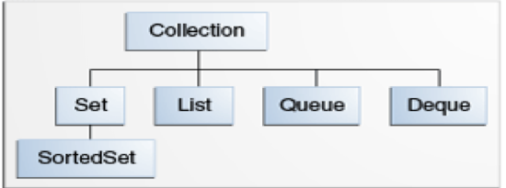
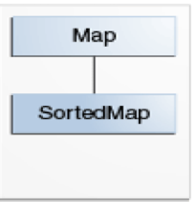
Collection and Map Interface
Collection Interface
d
is the root of the collection hierarchy
contains basic collection interfaces
Map Interface
contains collection-view operations
enables them to be manipulated as collections

Slide 6
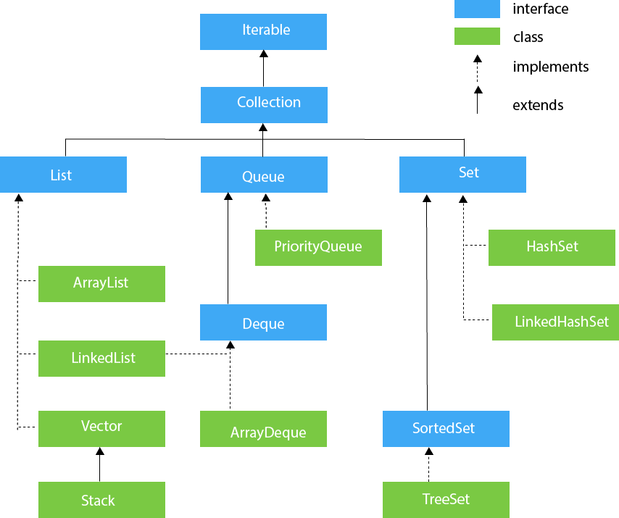
The Collection Interfaces

Slide 7
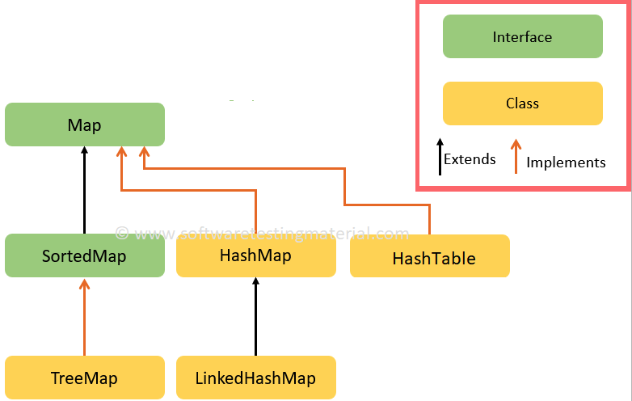
The Map Interfaces

Slide 8
The Collection Interface
the Collection interface supplies a common user interface to users of diverse classes and interfaces such as Set, SortedSet, Vector, LinkedList, ArrayList, and many others

Slide 9
The Basic Interfaces
the Collection interface specifies methods that all implementations must provide, including
isEmpty
add
remove
size

Slide 10
The Basic Interfaces
Set
no duplicate elements
examples:
{2, 3, 4, 5}
{Math, CS, Physics, Business}
implemented by
HashSet
TreeSet

Slide 11
The Basic Interfaces
HashSet
uses a hash table for storage
contains unique items
does not maintain sorting
TreeSet
uses a search tree
contains unique items
maintains sorting
Jane
Jane
1
Lisa
Bob
Lisa
Bob
2
Jane
Lisa
3
Bob

Slide 12
The Basic Interfaces
List
duplicate elements allowed
examples:
2 -> 3 -> 4 -> 5
Math -> CS -> Physics -> Math
implemented by
ArrayList
LinkedList

Slide 13


The Basic Interfaces
ArrayList
is a resizable array
grows its size to accommodate new elements
shrinks the size when the elements are removed
LinkedList
is a linear collection of elements whose order is not given by their physical placement in memory
each element points to the next

Slide 14
The Basic Interfaces
Queue
designed to hold elements prior to processing
typically uses a FIFO (first-in-first-out) design
implemented by PriorityQueue
Deque
pronounced as “deck”
a double-ended queue: can insert and delete elements at either end of the queue
implemented by ArrayDeque

Slide 15
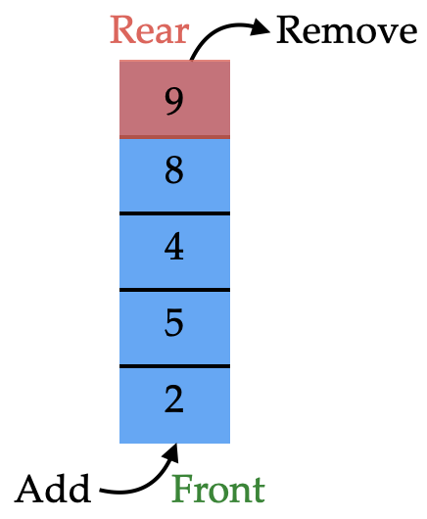
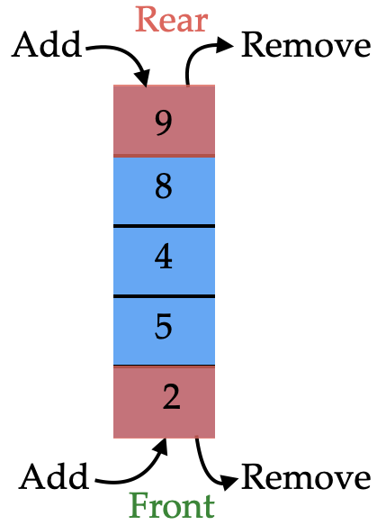
The Basic Interfaces
Queue
Deque

Slide 16
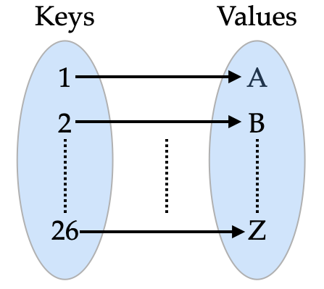
The Basic Interfaces
Map interface
represents objects that map keys to values
Values could be duplicated
example:
Implemented by
HashMap
TreeMap

Slide 17
The Basic Interfaces
HashMap
allows single null key, but can have multiple null values
Allows heterogeneous key values
TreeMap
sorts the keys in ascending order
allows only homogeneous key values

Slide 18
Iterator Interface
allows us to access elements of the collection
is used to iterate over the elements in the collection(Map, List or Set)
allows traversal only in the forward direction
iterator object is created by iterator method in the collection

Slide 19
Iterator Interface
an Iterator object has methods
hasNext (returns true if there are more elements in the iteration)
next (moves to the next element in the iteration)

Slide 20
Example
assume myList is a list of integers
this code creates an iterator that will iterate through the list, printing each value
Iterator<Integer> myItr = myList.iterator();
while(myItr.hasNext())
{ System.out.println(myItr.next());
}

Slide 21
Example
for(Integer i : myList)
{
System.out.println(i);
}
Note: This example can also be implemented using an enhanced for loop

Slide 22
Collections Class
Collections class
is a member of the Java Collection Framework
is in the java.util package
is used with the static methods, where all the methods
operate on the collections or return the collection
throw the NullPointerException if the collection or objects passed to the method is null

Slide 23
Collections Class
contains methods
reverse: reverse the ordering of the elements in the collection
Collections.reverse(myList)
sort: sort the elements in the collection
Collections.sort(myList)
binarySearch: search an element in the collection
Collections.binarySearch(myList, 5)

Slide 24
Summary

Slide 25
Sets
Identify the set among the following:
{2, 3, 4, 5}
{3, 5, 7, 3, 9}
Which of the following is true for the Tree set:
elements must be comparable
elements need not to be comparable

Slide 26
List
Which of the following is true for the List:
elements may be repeated
elements are not repeated
elements must be comparable
elements need not to be comparable

Slide 27
Queue
Which of the following is true for the Queue:
elements are removed in the same order as they have been added
elements are removed in the reverse order than they have been added

Slide 28
Map
Which of the following is true for the Map:
it is the same as a function mathematically
If true, then what is the domain of the function?
what is the co-domain of the function?

Slide 29
Java Collections Framework
The End

